Slide 1
Deep Learning
Zhen Li
mb75502@um.edu.mo

Slide 2
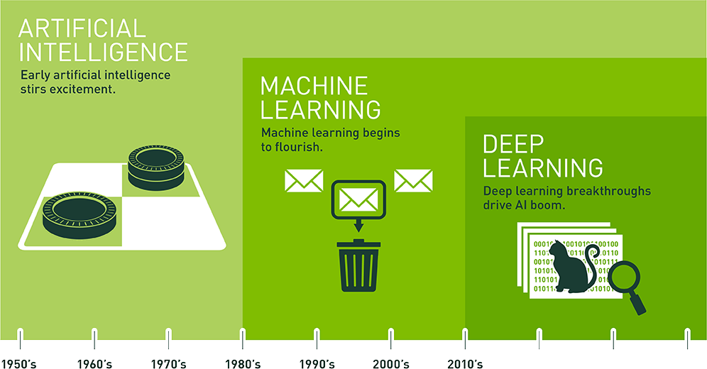
What is Deep Learning?

Slide 3
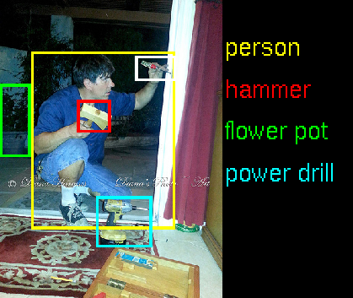
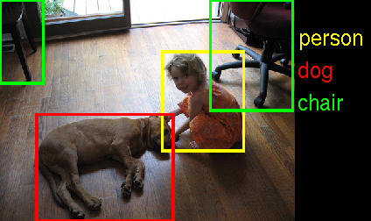
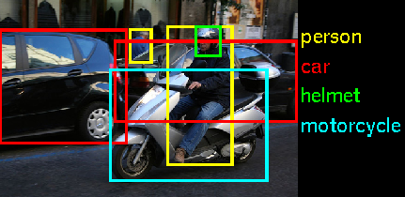
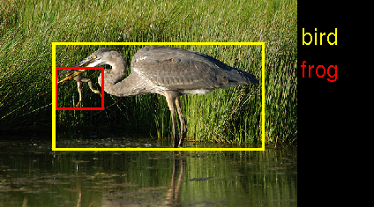
Deep Learning in Vision
Image Recognition
Notes:
Google DeepMind團隊將以機器學習技術分析匿名的視網膜掃瞄圖像資料
蔡明介：台灣想搞AI 再加2個零

Slide 4
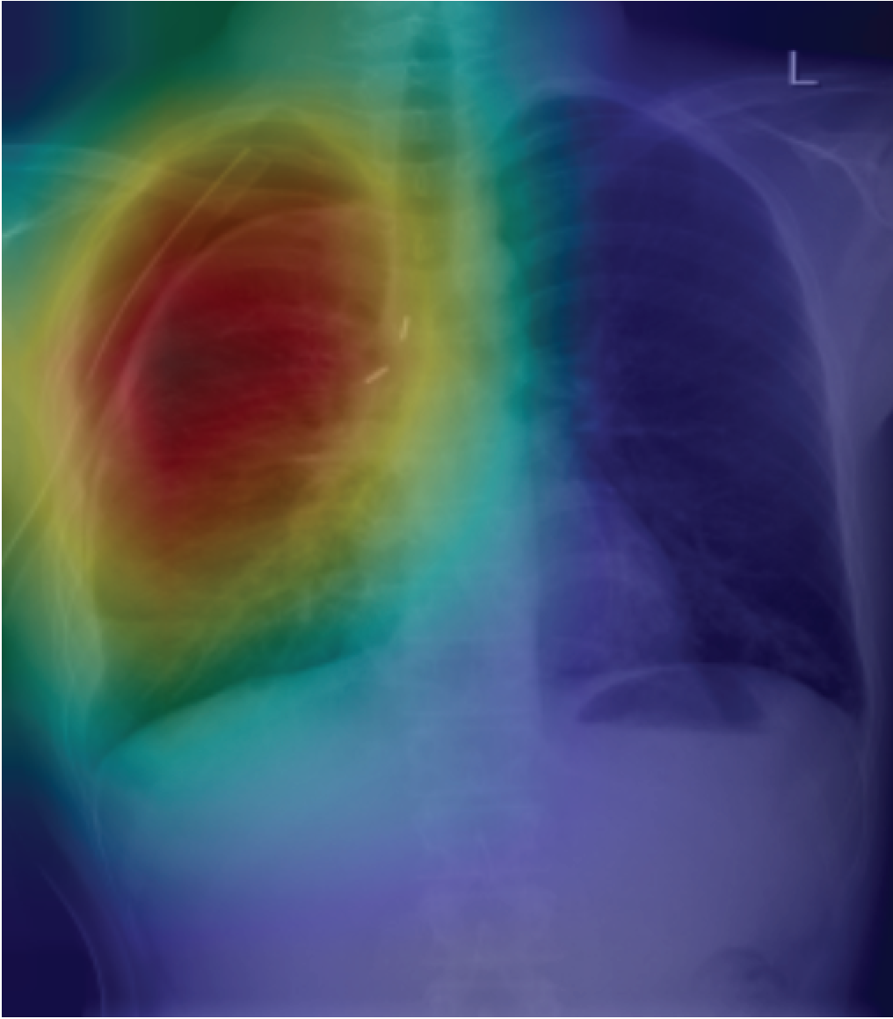
Deep Learning in Vision
Detection of pneumothorax (氣胸) in X-Ray scans
Notes:
Google DeepMind團隊將以機器學習技術分析匿名的視網膜掃瞄圖像資料
蔡明介：台灣想搞AI 再加2個零

Slide 5
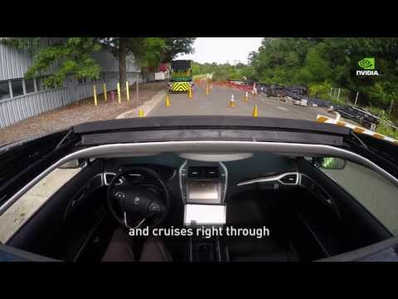
Deep Learning in Robotics
Self-Driving Cars
Notes:
Google DeepMind團隊將以機器學習技術分析匿名的視網膜掃瞄圖像資料
蔡明介：台灣想搞AI 再加2個零

Slide 6
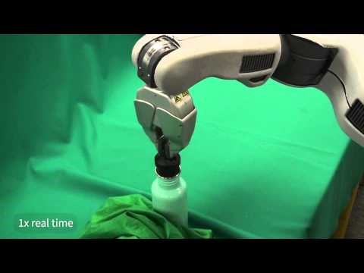
Deep Learning in Robotics
Robots
Notes:
Google DeepMind團隊將以機器學習技術分析匿名的視網膜掃瞄圖像資料
蔡明介：台灣想搞AI 再加2個零

Slide 7

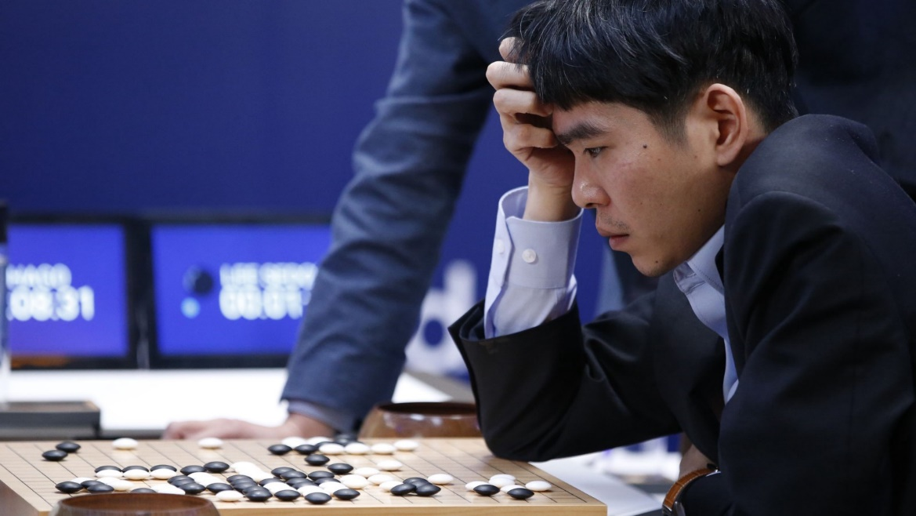
Deep Learning in Robotics
AlphaGo
vs
Lee Sedol
Notes:
Google DeepMind團隊將以機器學習技術分析匿名的視網膜掃瞄圖像資料
蔡明介：台灣想搞AI 再加2個零

Slide 8
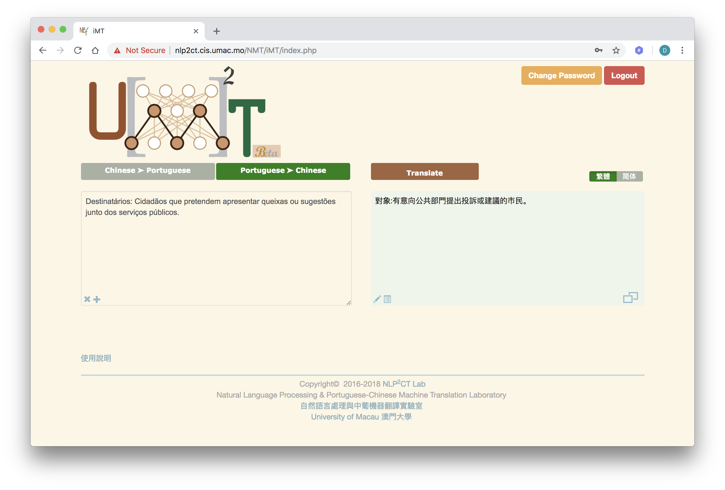
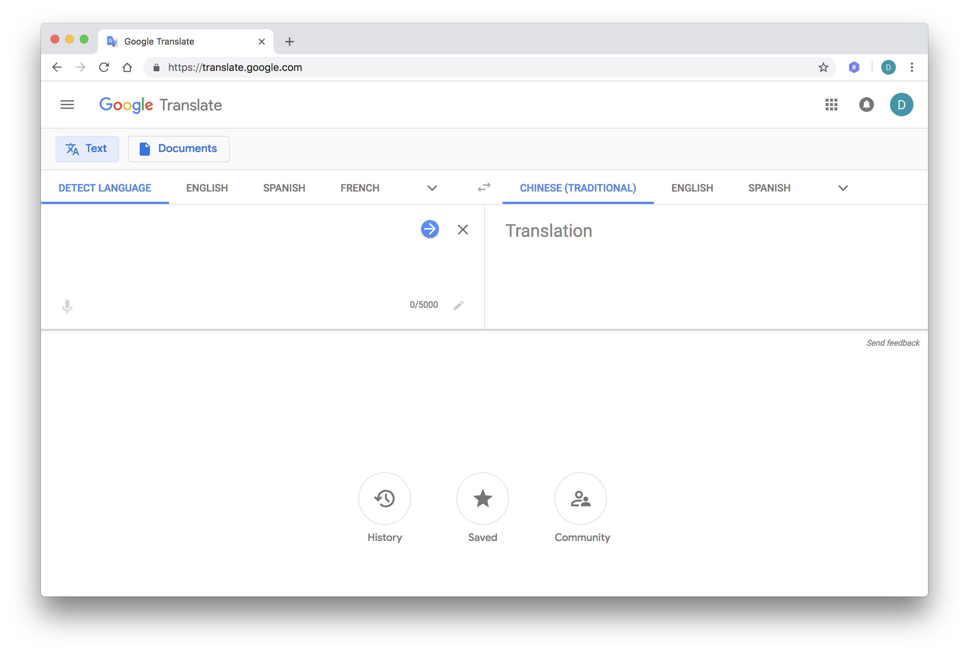
Deep Learning in Language&Speech
Machine Translation
機器翻譯
Notes:
Google DeepMind團隊將以機器學習技術分析匿名的視網膜掃瞄圖像資料
蔡明介：台灣想搞AI 再加2個零

Slide 9

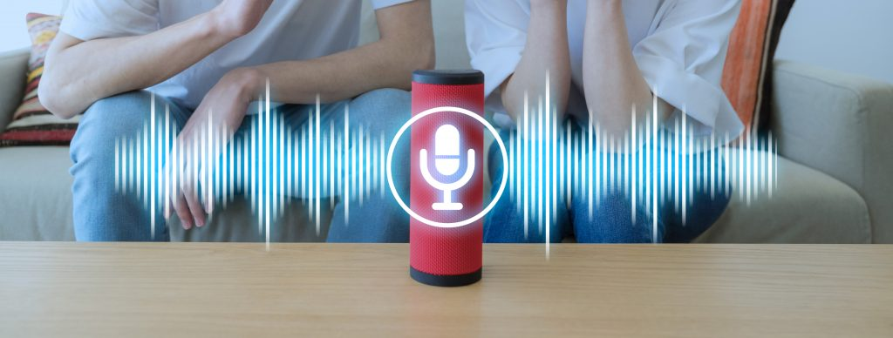
Deep Learning in Language&Speech
Chatbots
Notes:
Google DeepMind團隊將以機器學習技術分析匿名的視網膜掃瞄圖像資料
蔡明介：台灣想搞AI 再加2個零

Slide 10
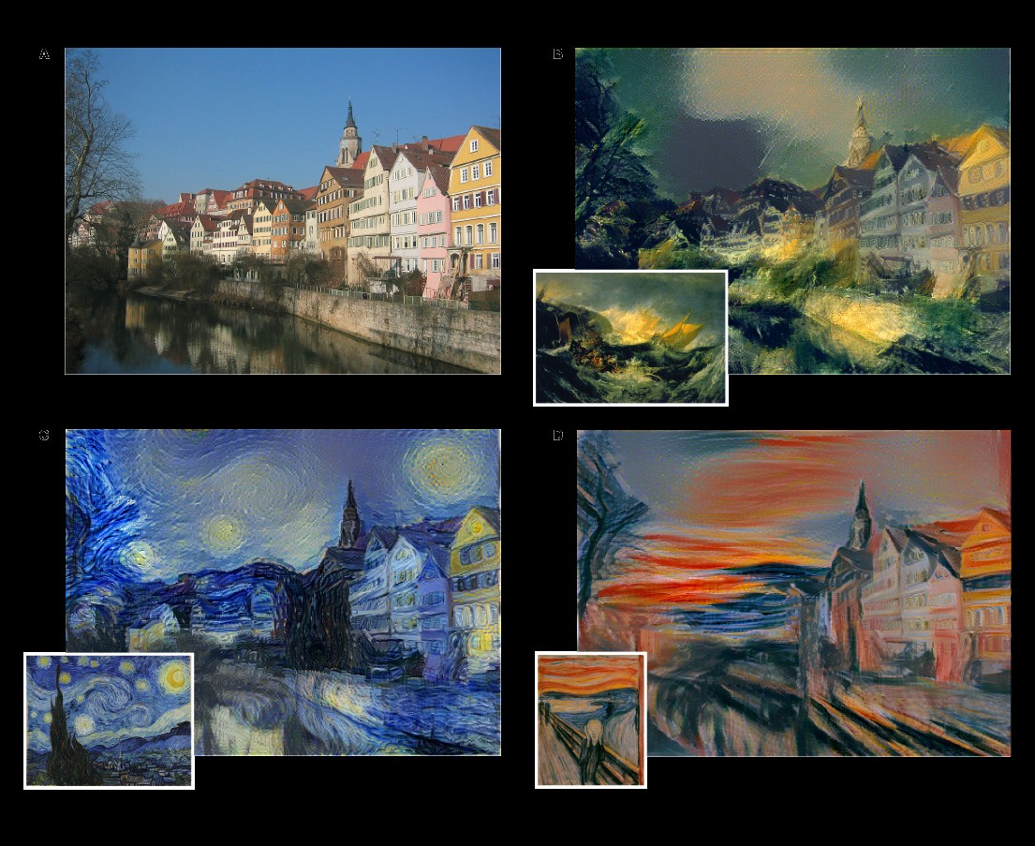
Deep Learning in Music&Arts
Style Transfer
Notes:
Google DeepMind團隊將以機器學習技術分析匿名的視網膜掃瞄圖像資料
蔡明介：台灣想搞AI 再加2個零

Slide 11
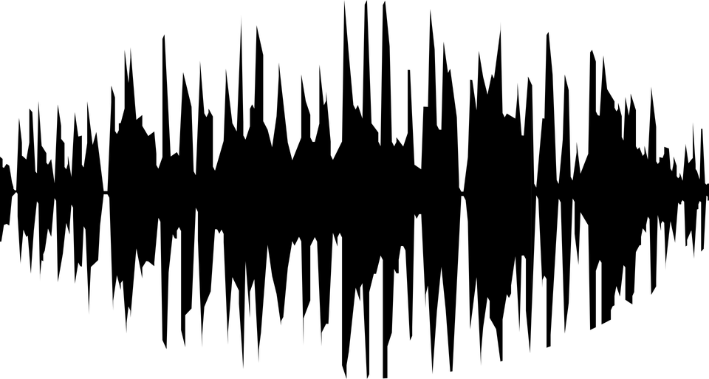
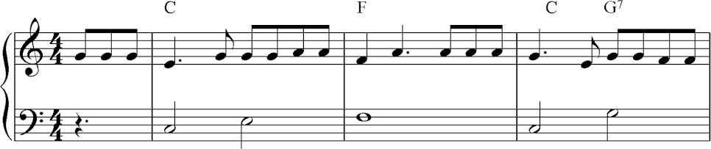
Deep Learning in Music&Arts
Music Generation
Notes:
Google DeepMind團隊將以機器學習技術分析匿名的視網膜掃瞄圖像資料
蔡明介：台灣想搞AI 再加2個零

Slide 12

Deep Learning Ho Sai Lei !!!

Slide 13
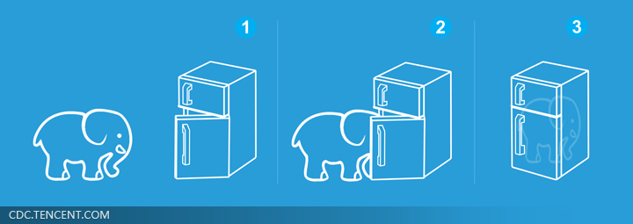
Three Steps for Deep Learning
Step 1: define a set of function
Step 2: goodness of function
Step 3: pick the best function
Neural
Network
Deep Learning is so simple ……
Notes:
http://www.twword.com/wiki/%E8%85%A6%E6%88%B6%E7%A9%B4
http://ukenglish.pixnet.net/blog/post/105691160-%E3%80%90%E5%8F%B0%E5%8D%97%E5%B8%82%E5%AD%B8%E8%8B%B1%E8%AA%9E%EF%BC%8C%E5%84%AA%E9%85%B7%E8%8B%B1%E8%AA%9E%E6%96%87%E7%90%86%E5%85%AC%E5%91%8A%E3%80%91%E6%9C%AC%E4%B8%AD%E5%BF%83
http://onepiece1234567890.blogspot.tw/2013/12/blog-post_8.html

Slide 14
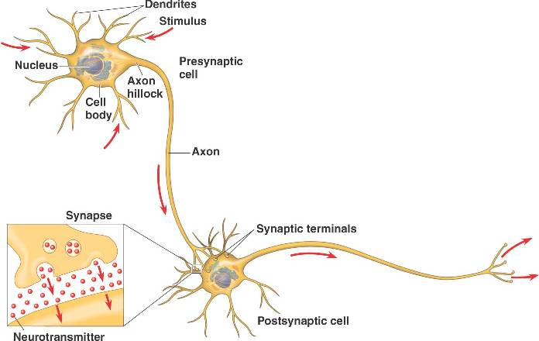
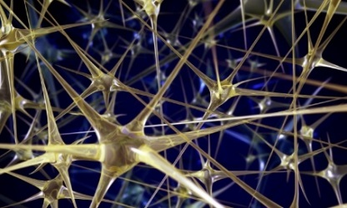
Neural Network
“Neuron”
Neural Network
Different connection leads to different network structures
Network parameter $θ$: all the weights and biases in the “neurons”
Notes:
瞬間潮了起來

Slide 15
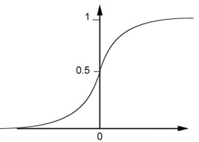
Fully Connect Feedforward Network
1
4
0.98
1
-2
1
-1
-2
0.12
-1
1
0
Sigmoid Function
Notes:
Ignore +

Slide 16
Fully Connect Feedforward Network
1
4
0.98
2
0.86
3
0.62
1
-2
-1
-1
1
0
-2
-1
-2
0.12
-2
0.11
-1
0.83
-1
1
-1
4
0
0
2

Slide 17
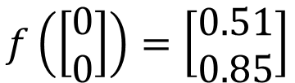
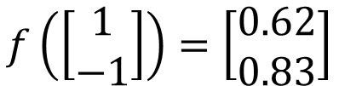
Fully Connect Feedforward Network
1
0.73
2
0.72
3
0.51
0
-2
-1
-1
1
0
-2
-1
0.5
-2
0.12
-1
0.85
0
1
-1
4
0
0
2
This is a function.
$$f\left(\left[\begin{matrix}1 \\ −1\end{matrix}\right]\right)=\left[\begin{matrix}0.62 \\ 0.83\end{matrix}\right]$$
$$f\left(\left[\begin{matrix}0 \\ 0\end{matrix}\right]\right)=\left[\begin{matrix}0.51 \\ 0.85\end{matrix}\right]$$
Input vector, output vector
Given network structure, define a function set
Notes:
For example, if we modify “1” to “2”, then we have another function

Slide 18
Fully Connect Feedforward Network
neuron
Input
Layer 1
Layer 2
Layer L
Output
……
y₁
……
y₂
……
……
……
……
……
……
y_{M}
Input Layer
Output Layer
Hidden Layers
Notes:
You can connect the neurons by other ways you like ☺
How many layer is deep?
CNN just another way to connect the neuros.
You can always connect the neurons in your own way.
“+” is ignored
Each dimension corresponds to a digit (10 dimension is needed)

Slide 19
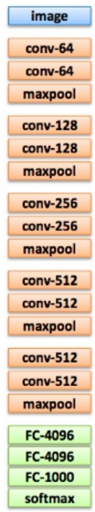
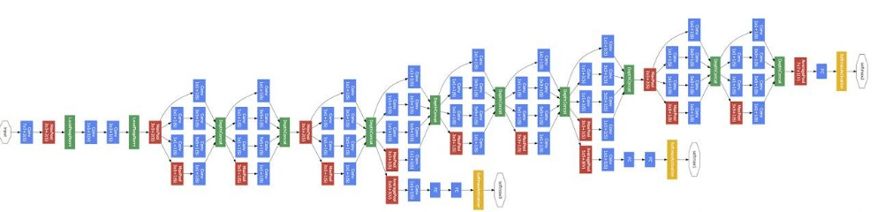
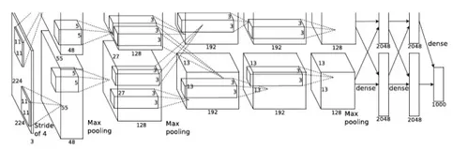
Deep = Many hidden layers
22 layers
http://cs231n.stanford.edu/slides/winter1516_lecture8.pdf
19 layers
8 layers
6.7%
7.3%
16.4%
AlexNet (2012)
VGG (2014)
GoogleNet (2014)

Slide 20
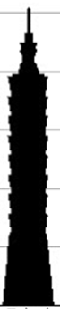
Deep = Many hidden layers
152 layers
101 layers
Special
structure
Ref: https://www.youtube.com/watch?v=dxB6299gpvI
3.57%
7.3%
6.7%
16.4%
AlexNet (2012)
VGG
(2014)
GoogleNet
(2014)
Residual Net
(2015)
Taipei
101
Notes:
169層

Slide 21
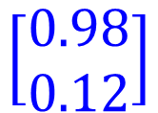
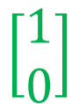
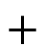
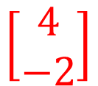
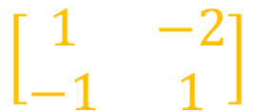
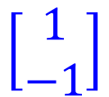
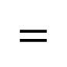
Matrix Operation
1
4
0.98
1
-2
1
-1
-2
0.12
-1
1
0
$$\left[\begin{matrix}1 & −2 \\ −1 & 1\end{matrix}\right]$$
$$\left[\begin{matrix}1 \\ −1\end{matrix}\right]$$
$$\left[\begin{matrix}1 \\ 0\end{matrix}\right]$$
$$=$$
$$\left[\begin{matrix}0.98 \\ 0.12\end{matrix}\right]$$
$$σ\left( \right)$$
$$+$$
$$\left[\begin{matrix}4 \\ −2\end{matrix}\right]$$
Notes:
Make sure you know how to do it
author: Adam Coates, Baidu, Inc.
Deep Learning (hopefully faster)
http://videolectures.net/deeplearning2015_coates_deep_learning/

Slide 22
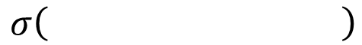
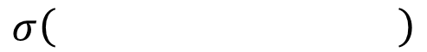
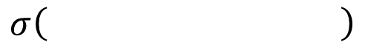
Neural Network
……
y₁
W¹
W²
W^{L}
……
y₂
b¹
b²
b^{L}
……
……
……
……
……
x
a¹
a²
y
……
y_{M}
W¹
x
b¹
+
$$σ\left( \right)$$
a¹
b²
W²
+
$$σ\left( \right)$$
W^{L}
b^{L}
a^{L-1}
+
$$σ\left( \right)$$
Notes:
Draw it?

Slide 23
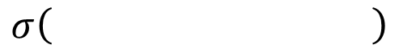
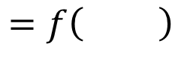
Neural Network
……
y₁
W¹
W²
W^{L}
……
y₂
b¹
b²
b^{L}
……
……
……
……
……
x
a¹
a²
y
……
y_{M}
y
x
Using parallel computing techniques to speed up matrix operation
$$=f\left( \right)$$
W^{L}
…
W²
W¹
x
b¹
b²
…
b^{L}
+
+
+
$$σ\left( \right)$$
$$=σ\left( \right)$$
$$σ\left( \right)$$
Notes:
Draw it?

Slide 24
Output Layer as Multi-Class Classifier
Feature extractor replacing feature engineering
……
y₁
……
y₂
Softmax
……
……
……
……
……
……
y_{M}
Input Layer
Output Layer
= Multi-class Classifier
Hidden Layers

Slide 25
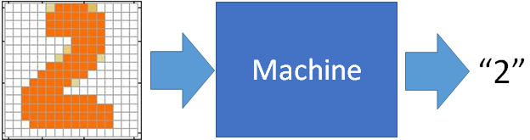
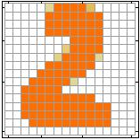
Example Application
Input
Output
y₁
is 1
0.1
y₂
is 2
0.7
The image is “2”
……
……
……
y₁₀
0.2
is 0
16 x 16 = 256
Ink → 1
No ink → 0
Each dimension represents the confidence of a digit.
Notes:
The same for even more complex tasks.

Slide 26
Example Application
Handwriting Digit Recognition
y₁
is 1
Machine
y₂
is 2
Neural
Network
“2”
……
……
……
y₁₀
is 0
What is needed is a function ……
Input:
256-dim vector
output:
10-dim vector
Notes:
The same approach for other cases

Slide 27
Example Application
Input
Layer 1
Layer 2
Layer L
Output
……
y₁
is 1
……
A function set containing the candidates for
Handwriting Digit Recognition
y₂
is 2
“2”
……
……
……
……
……
……
……
y₁₀
is 0
Input Layer
Output Layer
Hidden Layers
You need to decide the network structure to let a good function in your function set.
Notes:
CNN just another way to connect the neuros.
You can always connect the neurons in your own way.
“+” is ignored
Each dimension corresponds to a digit (10 dimension is needed)

Slide 28
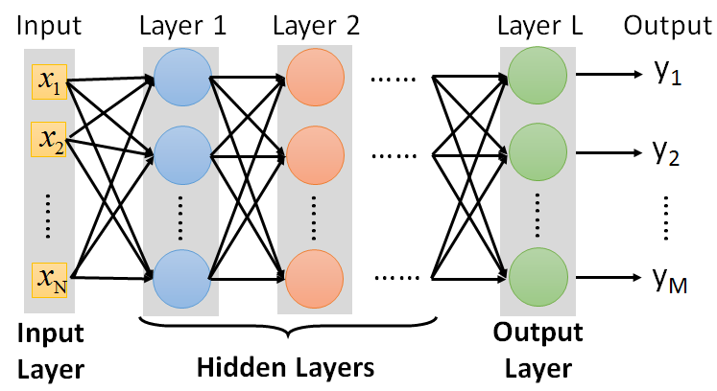
FAQ
Q: How many layers? How many neurons for each layer?
Q: Can the structure be automatically determined?
E.g. Evolutionary Artificial Neural Networks
Q: Can we design the network structure?
Trial and Error
+
Intuition
Convolutional Neural Network (CNN)

Slide 29
Three Steps for Deep Learning
Step 1: define a set of function
Step 2: goodness of function
Step 3: pick the best function
Neural
Network
Deep Learning is so simple ……
Notes:
http://www.twword.com/wiki/%E8%85%A6%E6%88%B6%E7%A9%B4
http://ukenglish.pixnet.net/blog/post/105691160-%E3%80%90%E5%8F%B0%E5%8D%97%E5%B8%82%E5%AD%B8%E8%8B%B1%E8%AA%9E%EF%BC%8C%E5%84%AA%E9%85%B7%E8%8B%B1%E8%AA%9E%E6%96%87%E7%90%86%E5%85%AC%E5%91%8A%E3%80%91%E6%9C%AC%E4%B8%AD%E5%BF%83
http://onepiece1234567890.blogspot.tw/2013/12/blog-post_8.html

Slide 30

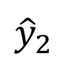
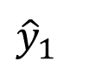
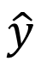
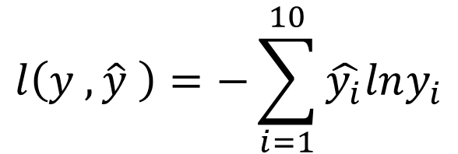
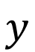
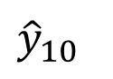
Loss for an Example
target
“1”
……
y₁
$${\hat{y}}_{1}$$
1
……
0
Given a set of parameters
y₂
$${\hat{y}}_{2}$$
Softmax
……
……
……
……
Cross
Entropy
……
……
……
y₁₀
0
$${\hat{y}}_{10}$$
$$y$$
$$\hat{y}$$
$$l\left(y ,\hat{y} \right)=−\sum_{i=1}^{10}{\hat{y_{i}}lny_{i}}$$
Notes:
https://www.youtube.com/watch?v=XWTfgehRxzU
You can never tind this in the textbook!
With softmax, the summation of all the ouputs would be one.
Can be considered as probability if you want ……

Slide 31


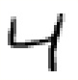
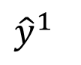
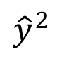
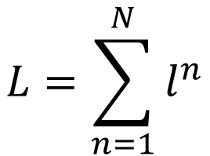








Total Loss
Total Loss:
$$L=\sum_{n=1}^{N}{l^{n}}$$
For all training data …
x¹
NN
y¹
$${\hat{y}}^{1}$$
$$l^{1}$$
NN
Find a function in function set that minimizes total loss L
x²
y²
$${\hat{y}}^{2}$$
$$l^{2}$$
x³
NN
y³
$${\hat{y}}^{3}$$
$$l^{3}$$
……
……
……
……
Find the network parameters $θ^{∗}$ that minimize total loss L
x^{N}
NN
y^{N}
$${\hat{y}}^{N}$$
$$l^{N}$$
Notes:
Randomly picked one
Two approaches update the parameters towards the same direction, but stochastic is faster!
Better!

Slide 32
Three Steps for Deep Learning
Step 1: define a set of function
Step 2: goodness of function
Step 3: pick the best function
Neural
Network
Deep Learning is so simple ……
Notes:
http://www.twword.com/wiki/%E8%85%A6%E6%88%B6%E7%A9%B4
http://ukenglish.pixnet.net/blog/post/105691160-%E3%80%90%E5%8F%B0%E5%8D%97%E5%B8%82%E5%AD%B8%E8%8B%B1%E8%AA%9E%EF%BC%8C%E5%84%AA%E9%85%B7%E8%8B%B1%E8%AA%9E%E6%96%87%E7%90%86%E5%85%AC%E5%91%8A%E3%80%91%E6%9C%AC%E4%B8%AD%E5%BF%83
http://onepiece1234567890.blogspot.tw/2013/12/blog-post_8.html

Slide 33

Gradient Descent
Algorithm
Initialize weights randomly $\sim 𝒩(0,σ^{2})$
Loop until convergence
Compute gradient: $\frac{∂𝒥\left(θ\right)}{∂θ}$
Update weights: $θ←θ−α$ $\frac{∂𝒥\left(θ\right)}{∂θ}$
Return weights

Slide 34













Backpropagation (反向傳播)
Compute Gradients
$$z_{1}$$
$$x_{1}$$
$$θ_{1}$$
$$θ_{2}$$
$$z_{2}$$
$$\hat{y}$$
$$𝒥\left(θ\right)$$
$$x_{2}$$
$$z_{3}$$
Chain Rule (連鎖法則)!
$$\frac{∂𝒥\left(θ\right)}{∂θ_{2}}$$
$$=\frac{∂𝒥\left(θ\right)}{∂\hat{y}}×\frac{∂\hat{y}}{∂θ_{2}}$$
$$\frac{∂𝒥\left(θ\right)}{∂θ_{1}}=\frac{∂𝒥\left(θ\right)}{∂\hat{y}}×\frac{∂\hat{y}}{∂θ_{1}}$$
$$=\frac{∂𝒥\left(θ\right)}{∂\hat{y}}×\frac{∂\hat{y}}{∂z_{2}}×\frac{∂z_{2}}{∂θ_{1}}$$

Slide 35

Compute Gradient Example 1

Slide 36

Compute Gradient Example 2

Slide 37

Compute Gradient Example 3

Slide 38
Compute Gradient Example 4

Slide 39

Compute Gradient Example 5

Slide 40

Compute Gradient Example 6

Slide 41
Compute Gradient Example 7

Slide 42

Compute Gradient Example 8

Slide 43

Compute Gradient Example 9

Slide 44

Compute Gradient Example 10

Slide 45

Compute Gradient Example 11

Slide 46

Compute Gradient Example 12

Slide 47

Compute Gradient Example 13

Slide 48
Convolutional Neural Network

Slide 49


Why CNN for Image
Some patterns are much smaller than the whole image
A neuron does not have to see the whole image to discover the pattern.
Connecting to small region with less parameters
“beak” detector

Slide 50


Why CNN for Image
The same patterns appear in different regions.
“upper-left beak” detector
Do almost the same thing
They can use the same set of parameters.
“middle beak” detector

Slide 51


Why CNN for Image
Subsampling the pixels will not change the object
bird
bird
subsampling
We can subsample the pixels to make image smaller
Less parameters for the network to process the image

Slide 52


The whole CNN
cat dog ……
Convolution
Max Pooling
Can repeat many times
Fully Connected Feedforward network
Convolution
Max Pooling
Flatten

Slide 53
The whole CNN
Property 1
Some patterns are much smaller than the whole image
Convolution
Property 2
Max Pooling
The same patterns appear in different regions.
Can repeat many times
Property 3
Convolution
Subsampling the pixels will not change the object
Max Pooling
Flatten

Slide 54
The whole CNN
cat dog ……
Convolution
Max Pooling
Can repeat many times
Fully Connected Feedforward network
Convolution
Max Pooling
Flatten

Slide 55
CNN – Convolution
Those are the network parameters to be learned.
1 | -1 | -1
-1 | 1 | -1
-1 | -1 | 1
1 | 0 | 0 | 0 | 0 | 1
0 | 1 | 0 | 0 | 1 | 0
0 | 0 | 1 | 1 | 0 | 0
1 | 0 | 0 | 0 | 1 | 0
0 | 1 | 0 | 0 | 1 | 0
0 | 0 | 1 | 0 | 1 | 0
Filter 1
Matrix
-1 | 1 | -1
-1 | 1 | -1
-1 | 1 | -1
Filter 2
Matrix
……
6 x 6 image
Each filter detects a small pattern (3 x 3).
Property 1

Slide 56
CNN – Convolution
1 | -1 | -1
-1 | 1 | -1
-1 | -1 | 1
Filter 1
stride=1
1 | 0 | 0 | 0 | 0 | 1
0 | 1 | 0 | 0 | 1 | 0
0 | 0 | 1 | 1 | 0 | 0
1 | 0 | 0 | 0 | 1 | 0
0 | 1 | 0 | 0 | 1 | 0
0 | 0 | 1 | 0 | 1 | 0
3
-1
6 x 6 image

Slide 57
CNN – Convolution
1 | -1 | -1
-1 | 1 | -1
-1 | -1 | 1
Filter 1
If stride=2
1 | 0 | 0 | 0 | 0 | 1
0 | 1 | 0 | 0 | 1 | 0
0 | 0 | 1 | 1 | 0 | 0
1 | 0 | 0 | 0 | 1 | 0
0 | 1 | 0 | 0 | 1 | 0
0 | 0 | 1 | 0 | 1 | 0
3
-3
We set stride=1 below
6 x 6 image

Slide 58
CNN – Convolution
1 | -1 | -1
-1 | 1 | -1
-1 | -1 | 1
Filter 1
stride=1
1 | 0 | 0 | 0 | 0 | 1
0 | 1 | 0 | 0 | 1 | 0
0 | 0 | 1 | 1 | 0 | 0
1 | 0 | 0 | 0 | 1 | 0
0 | 1 | 0 | 0 | 1 | 0
0 | 0 | 1 | 0 | 1 | 0
3
-1
-3
-1
-3
1
0
-3
-3
-3
0
1
3
-2
-2
-1
6 x 6 image
Property 2

Slide 59
CNN – Convolution
-1 | 1 | -1
-1 | 1 | -1
-1 | 1 | -1
Filter 2
stride=1
Do the same process for every filter
1 | 0 | 0 | 0 | 0 | 1
0 | 1 | 0 | 0 | 1 | 0
0 | 0 | 1 | 1 | 0 | 0
1 | 0 | 0 | 0 | 1 | 0
0 | 1 | 0 | 0 | 1 | 0
0 | 0 | 1 | 0 | 1 | 0
3
-1
-3
-1
-1
-1
-1
-1
-3
1
0
-3
-1
-1
-2
1
Feature
Map
-3
-3
0
1
-1
-1
-2
1
3
-2
-2
-1
6 x 6 image
-1
0
-4
3
4 x 4 image

Slide 60

CNN – Colorful image
1 | -1 | -1
-1 | 1 | -1
-1 | -1 | 1
-1 | 1 | -1
-1 | 1 | -1
-1 | 1 | -1
1 | -1 | -1
-1 | 1 | -1
-1 | -1 | 1
-1 | 1 | -1
-1 | 1 | -1
-1 | 1 | -1
1 | -1 | -1
-1 | 1 | -1
-1 | -1 | 1
-1 | 1 | -1
-1 | 1 | -1
-1 | 1 | -1
Filter 1
Filter 2
Colorful image
1 | 0 | 0 | 0 | 0 | 1
0 | 1 | 0 | 0 | 1 | 0
0 | 0 | 1 | 1 | 0 | 0
1 | 0 | 0 | 0 | 1 | 0
0 | 1 | 0 | 0 | 1 | 0
0 | 0 | 1 | 0 | 1 | 0
1 | 0 | 0 | 0 | 0 | 1
0 | 1 | 0 | 0 | 1 | 0
0 | 0 | 1 | 1 | 0 | 0
1 | 0 | 0 | 0 | 1 | 0
0 | 1 | 0 | 0 | 1 | 0
0 | 0 | 1 | 0 | 1 | 0
1 | 0 | 0 | 0 | 0 | 1
0 | 1 | 0 | 0 | 1 | 0
0 | 0 | 1 | 1 | 0 | 0
1 | 0 | 0 | 0 | 1 | 0
0 | 1 | 0 | 0 | 1 | 0
0 | 0 | 1 | 0 | 1 | 0

Slide 61

Convolution v.s. Fully Connected
1 | 0 | 0 | 0 | 0 | 1
0 | 1 | 0 | 0 | 1 | 0
0 | 0 | 1 | 1 | 0 | 0
1 | 0 | 0 | 0 | 1 | 0
0 | 1 | 0 | 0 | 1 | 0
0 | 0 | 1 | 0 | 1 | 0
1 | -1 | -1
-1 | 1 | -1
-1 | -1 | 1
-1 | 1 | -1
-1 | 1 | -1
-1 | 1 | -1
convolution
image
1 | 0 | 0 | 0 | 0 | 1
0 | 1 | 0 | 0 | 1 | 0
0 | 0 | 1 | 1 | 0 | 0
1 | 0 | 0 | 0 | 1 | 0
0 | 1 | 0 | 0 | 1 | 0
0 | 0 | 1 | 0 | 1 | 0
Fully-connected
……
……

Slide 62

1 | -1 | -1
-1 | 1 | -1
-1 | -1 | 1
1:
1
Filter 1
2:
0
3:
0
3
4:
0
1 | 0 | 0 | 0 | 0 | 1
0 | 1 | 0 | 0 | 1 | 0
0 | 0 | 1 | 1 | 0 | 0
1 | 0 | 0 | 0 | 1 | 0
0 | 1 | 0 | 0 | 1 | 0
0 | 0 | 1 | 0 | 1 | 0
…
7:
0
8:
1
9:
0
10:
0
…
13:
0
6 x 6 image
14:
0
Less parameters!
15:
Only connect to 9 input, not fully connected
1
16:
1
…

Slide 63

1 | -1 | -1
-1 | 1 | -1
-1 | -1 | 1
1:
1
Filter 1
2:
0
3:
0
3
4:
0
1 | 0 | 0 | 0 | 0 | 1
0 | 1 | 0 | 0 | 1 | 0
0 | 0 | 1 | 1 | 0 | 0
1 | 0 | 0 | 0 | 1 | 0
0 | 1 | 0 | 0 | 1 | 0
0 | 0 | 1 | 0 | 1 | 0
…
7:
0
8:
1
-1
9:
0
10:
0
…
13:
0
6 x 6 image
14:
0
Less parameters!
15:
1
16:
1
Shared weights
Even less parameters!
…

Slide 64
The whole CNN
cat dog ……
Convolution
Max Pooling
Can repeat many times
Fully Connected Feedforward network
Convolution
Max Pooling
Flatten

Slide 65
CNN – Max Pooling
1 | -1 | -1
-1 | 1 | -1
-1 | -1 | 1
-1 | 1 | -1
-1 | 1 | -1
-1 | 1 | -1
Filter 1
Filter 2
3
-1
-3
-1
-1
-1
-1
-1
-3
1
0
-3
-1
-1
-2
1
-3
-3
0
1
-1
-1
-2
1
3
-2
-2
-1
-1
0
-4
3

Slide 66
CNN – Max Pooling
New image
but smaller
1 | 0 | 0 | 0 | 0 | 1
0 | 1 | 0 | 0 | 1 | 0
0 | 0 | 1 | 1 | 0 | 0
1 | 0 | 0 | 0 | 1 | 0
0 | 1 | 0 | 0 | 1 | 0
0 | 0 | 1 | 0 | 1 | 0
Conv
3
0
-1
1
Max
Pooling
3
1
0
3
2 x 2 image
6 x 6 image
Each filter
is a channel

Slide 67
The whole CNN
3
0
-1
1
Convolution
3
1
0
3
Max Pooling
Can repeat many times
A new image
Convolution
Smaller than the original image
The number of the channel is the number of filters
Max Pooling

Slide 68
The whole CNN
cat dog ……
Convolution
Max Pooling
A new image
Fully Connected Feedforward network
Convolution
Max Pooling
A new image
Flatten

Slide 69
Flatten
3
0
1
3
0
-1
1
3
3
1
-1
0
3
Flatten
1
Fully Connected Feedforward network
0
3

Slide 70


CNN in Keras
Only modified the network structure and input format (vector -> 3-D tensor)
input
Convolution
1 | -1 | -1
-1 | 1 | -1
-1 | -1 | 1
-1 | 1 | -1
-1 | 1 | -1
-1 | 1 | -1
There are 25 3x3 filters.
……
Max Pooling
Input_shape = ( 28 , 28 , 1)
28 x 28 pixels
1: black/white, 3: RGB
Convolution
3
-1
3
Max Pooling
-3
1

Slide 71
CNN in Keras
Only modified the network structure and input format (vector -> 3-D tensor)
input
1 x 28 x 28
Convolution
How many parameters for each filter?
9
25 x 26 x 26
Max Pooling
25 x 13 x 13
Convolution
How many parameters for each filter?
225
50 x 11 x 11
Max Pooling
50 x 5 x 5

Slide 72

CNN in Keras
Only modified the network structure and input format (vector -> 3-D tensor)
input
1 x 28 x 28
output
Convolution
25 x 26 x 26
Fully Connected Feedforward network
Max Pooling
25 x 13 x 13
Convolution
50 x 11 x 11
Max Pooling
1250
50 x 5 x 5
Flatten

Slide 73



DL Framework

Slide 74
Tensorflow complicated, but powerful Pytorch easy, flexible Keras Very easy, but a little bit not flexible

Slide 75
Keras
François Chollet is the author of Keras.
He currently works for Google as a deep learning engineer and researcher.
Keras means horn in Greek
Documentation: http://keras.io/
Example: https://github.com/fchollet/keras/tree/master/examples

Slide 76

使用 Keras 心得

Slide 77

“Hello world”
Handwriting Digit Recognition
Machine
“1”
28 x 28
MNIST Data: http://yann.lecun.com/exdb/mnist/
Keras provides data sets loading function: http://keras.io/datasets/

Slide 78




Keras
28x28
……
500
……
softplus, softsign, relu, tanh, hard_sigmoid, linear
500
……
Softmax
y₁
y₂
y₁₀
……
Notes:
https://en.wikipedia.org/wiki/Activation_function
Theno: Universite de Montr ´ eal
Yoshua Bengio

Slide 79


Keras
Several alternatives: https://keras.io/objectives/
Notes:
Theno: Universite de Montr ´ eal
Yoshua Bengio

Slide 80
Keras
Step 3.1: Configuration
SGD, RMSprop, Adagrad, Adadelta, Adam, Adamax, Nadam
Step 3.2: Find the optimal network parameters
Training data
(Images)
Labels
(digits)
In the following slides
Notes:
Theno: Universite de Montr ´ eal
Yoshua Bengio

Slide 81


Keras
Step 3.2: Find the optimal network parameters
numpy array
numpy array
28 x 28
=784
……
10
……
Number of training examples
Number of training examples
https://www.tensorflow.org/versions/r0.8/tutorials/mnist/beginners/index.html
Notes:
Theno: Universite de Montr ´ eal
Yoshua Bengio

Slide 82
Mini-batch
We do not really minimize total loss!
Randomly initialize network parameters
x¹
NN
y¹
Pick the 1st batch
$${\hat{y}}^{1}$$
$$l^{1}$$
$$L′=l^{1}+l^{31}+⋯$$
Mini-batch
NN
x³¹
y³¹
$${\hat{y}}^{31}$$
Update parameters once
$$l^{31}$$
Pick the 2nd batch
……
$$L′′=l^{2}+l^{16}+⋯$$
Update parameters once
x²
NN
y²
$${\hat{y}}^{2}$$
$$l^{2}$$
…
Until all mini-batches have been picked
Mini-batch
x¹⁶
NN
y¹⁶
$${\hat{y}}^{16}$$
$$l^{16}$$
one epoch
……
Repeat the above process
Notes:
Each time we update paramters, we have different target -> 不安
Shuffle data, and repeat above process

Slide 83
Mini-batch
Batch size influences both speed and performance. You have to tune it.
Pick the 1st batch
x¹
NN
y¹
$${\hat{y}}^{1}$$
$$L′=l^{1}+l^{31}+⋯$$
$$l^{1}$$
Mini-batch
NN
Update parameters once
x³¹
y³¹
$${\hat{y}}^{31}$$
$$l^{31}$$
Pick the 2nd batch
……
$$L′′=l^{2}+l^{16}+⋯$$
100 examples in a mini-batch
Update parameters once
Batch size = 1
…
Until all mini-batches have been picked
Stochastic gradient descent
Repeat 20 times
one epoch
Notes:
Let’s try it.

Slide 84
Acknowledgements
Most of the presentation contents are derived from the following materials:
http://speech.ee.ntu.edu.tw/~tlkagk/courses_ML17.html

